Slide 1
Payment data analysis on Olist Ecommerce dataset
in 2017-2018

Slide 2

Olist is a Brazilian e-commerce platform that connects small and medium-sized businesses to customers across Brazil. The platform operates as a marketplace, where merchants can list their products and services and customers can browse and purchase them online.
Total revenue (cost+freight)
for 2017 – 7.249.746,73
for 2018 – 8.699.763,05

Slide 3
Tasks for the analysis:
1. how many customers chose to pay via installments and what are the top categories/revenue with orders that had installments, does it differ with the amount of installments chosen by customer
2. what are the payment methods used by customers, how many clients use each method and how much is revenue, how the choice of payment method differs across the states of Olist presence
3. how long it takes for the seller to accept the order, to ship it out and for the order to be delivered to customer, does the estimation of delivery match the actual time

Slide 4
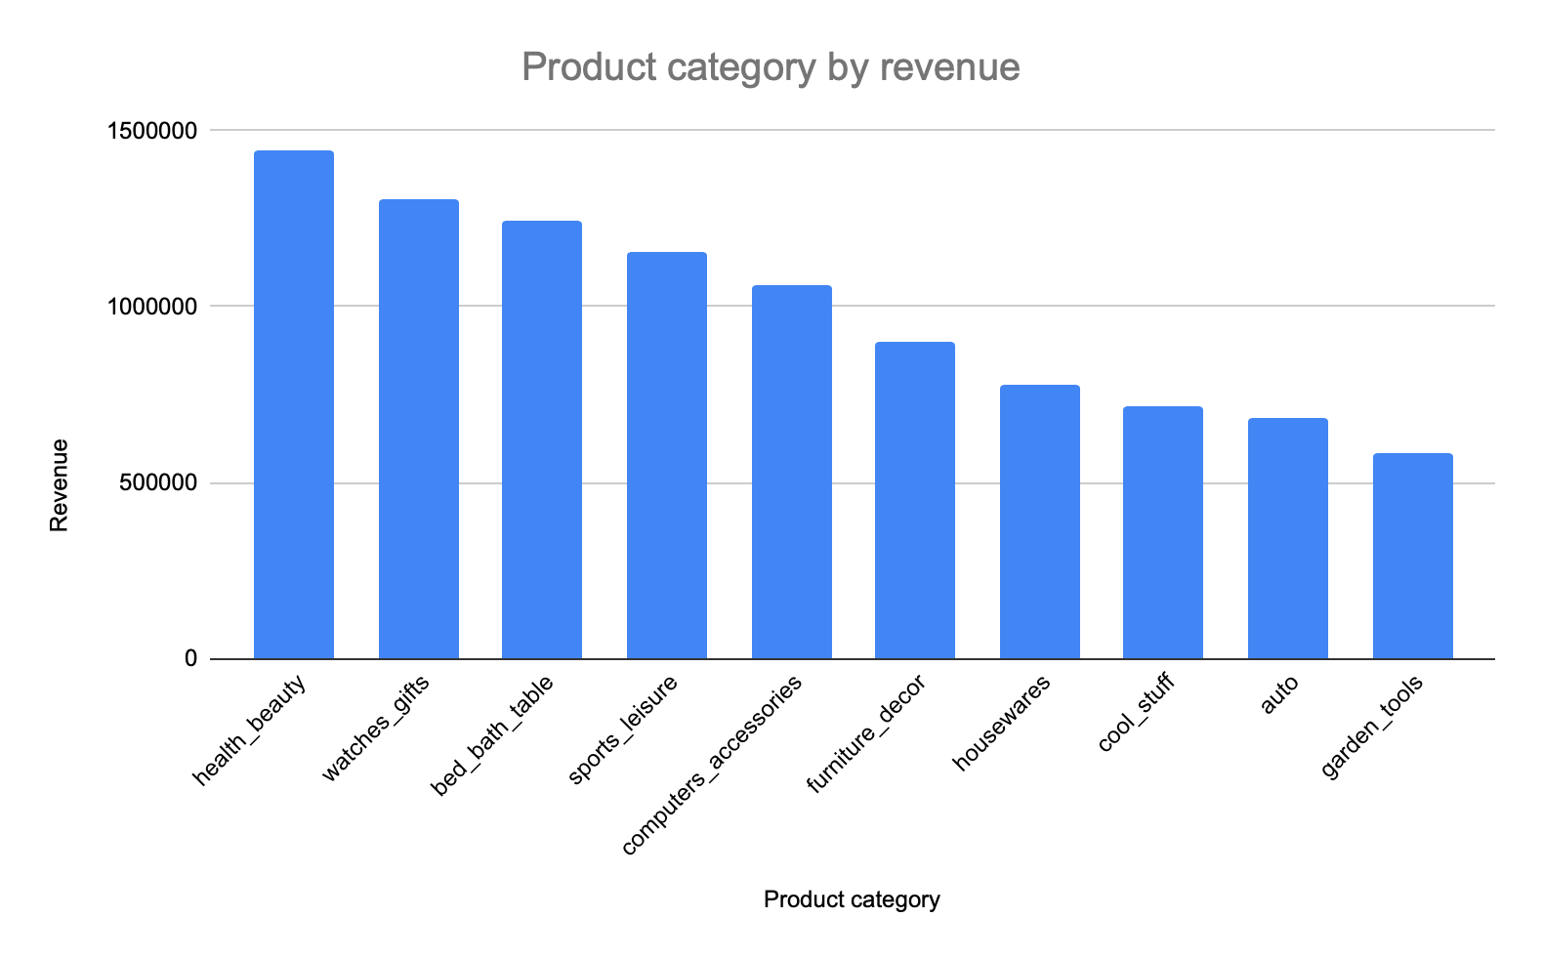
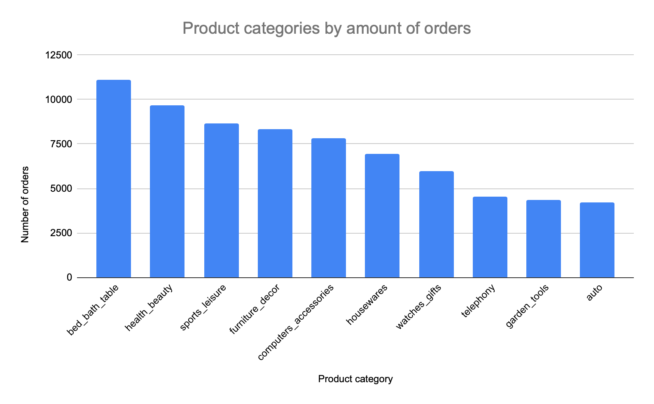
Top 10 product categories

Slide 5
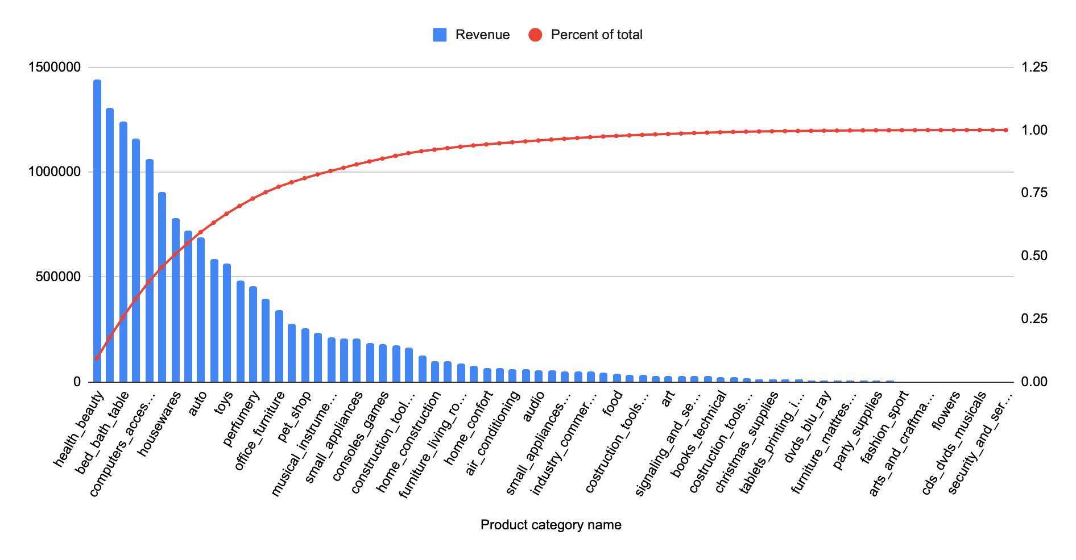
The first 16 categories (out of 71) comprise roughly 80% of total revenue. That is ~22% of all categories, so Pareto principle applies in this case.
Product categories by revenue - Pareto

Slide 6
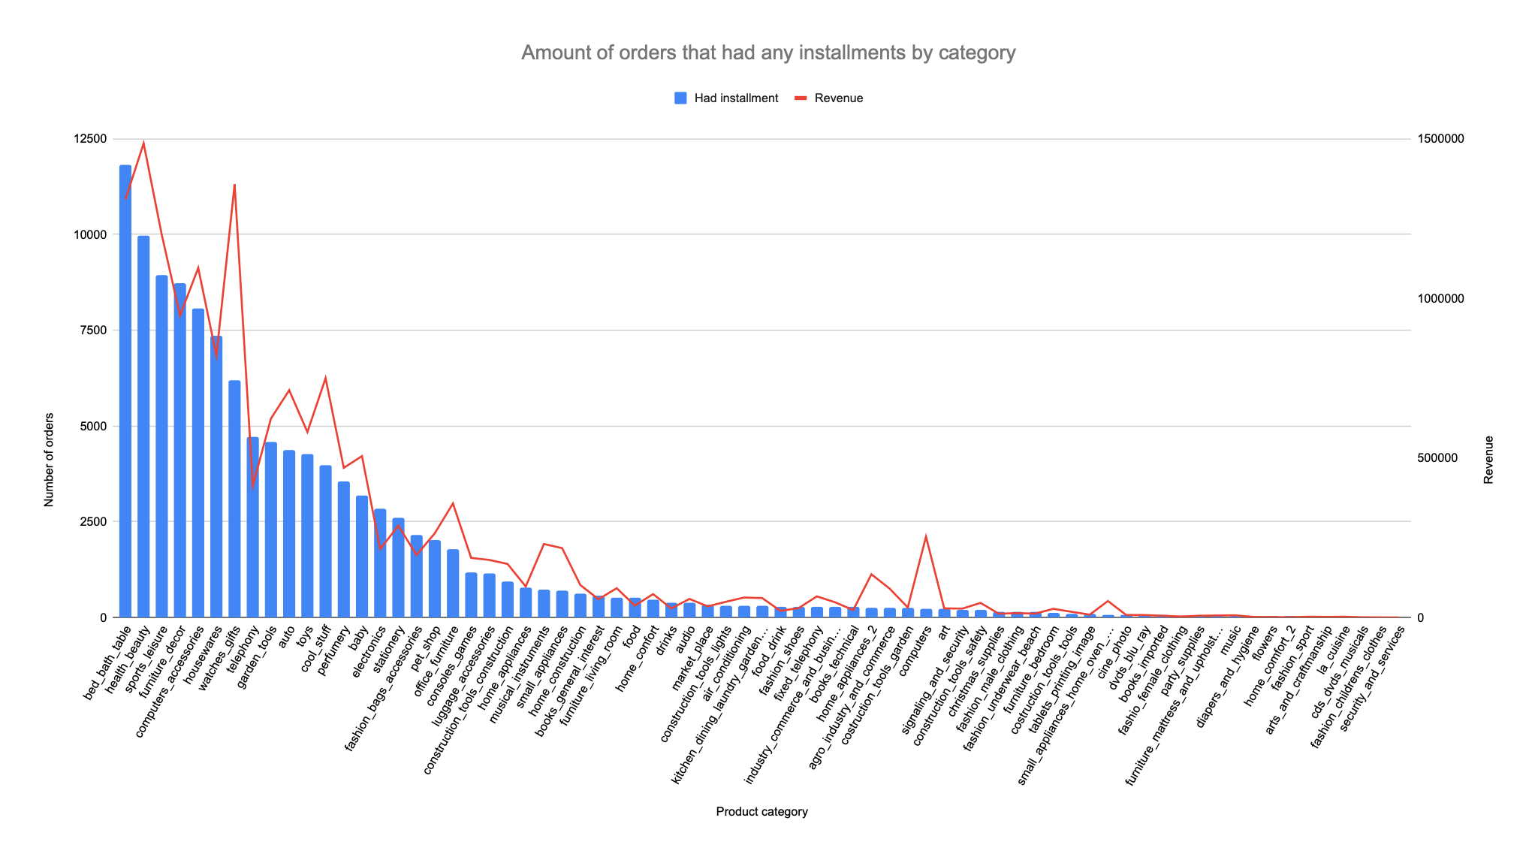
1. Installments analysis

Slide 7
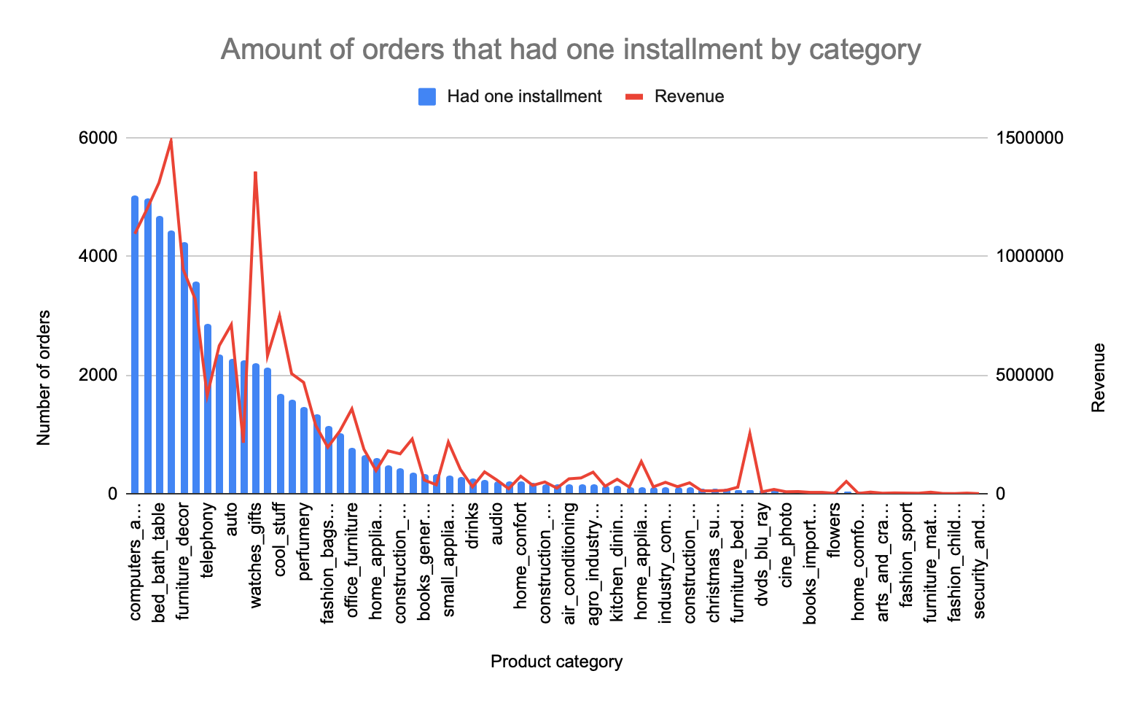
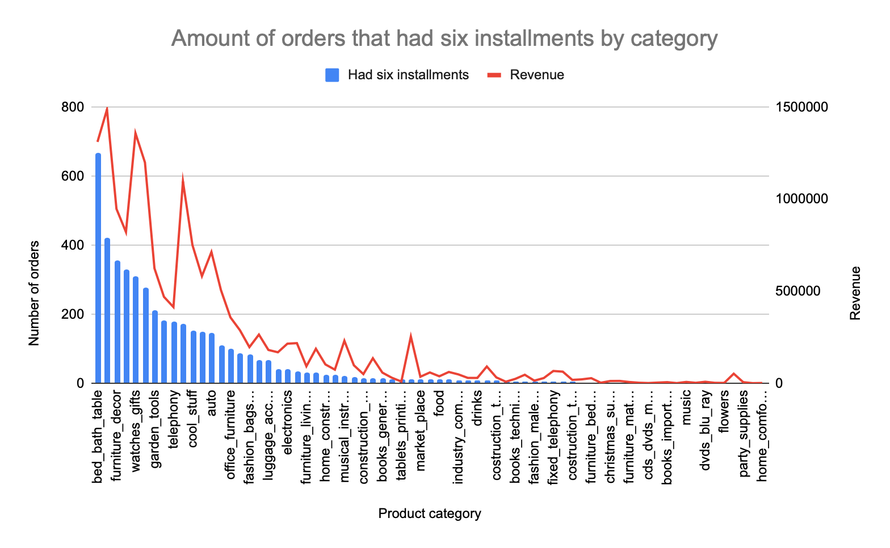
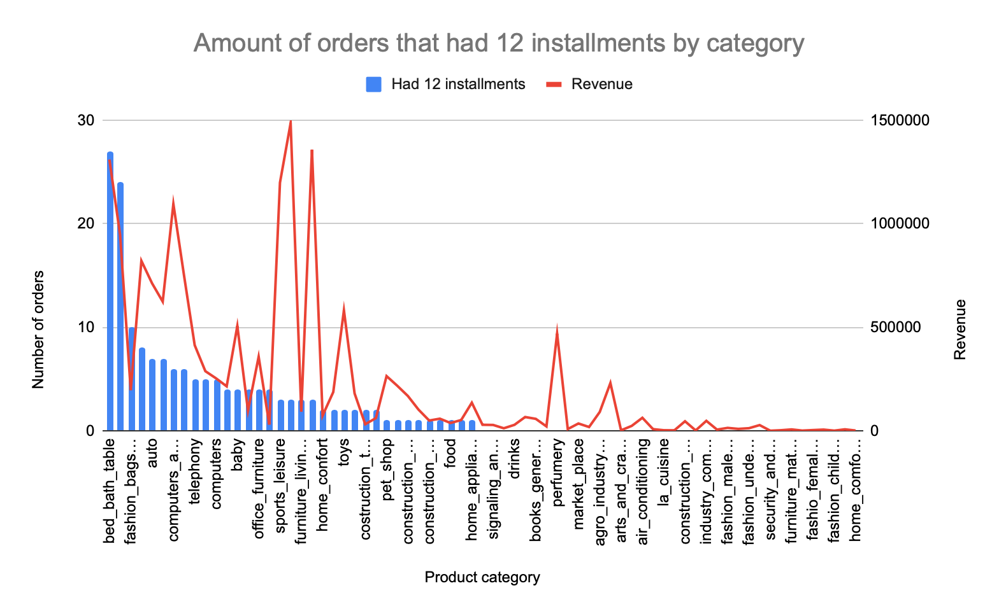
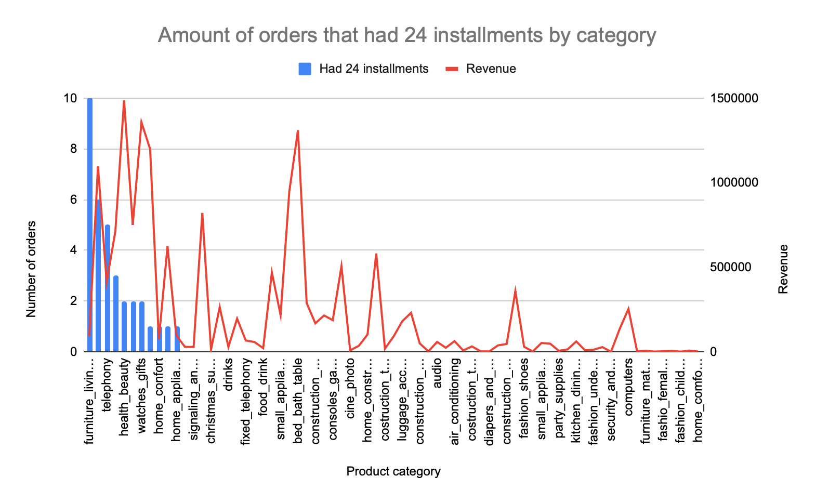
Examples of amount of orders/category distribution by the amount of installments
Most of the customers that chose to pay via installment had 1-3 installments (with max N of orders 5027 that had one installment and max N of orders that had 3 installments – 1232, and it is decreasing further with the increase in N of installments)
Out of 71 product categories the maximum length of installment plan (24 months) is used only in 11 categories with max N of orders – 10.

Slide 8
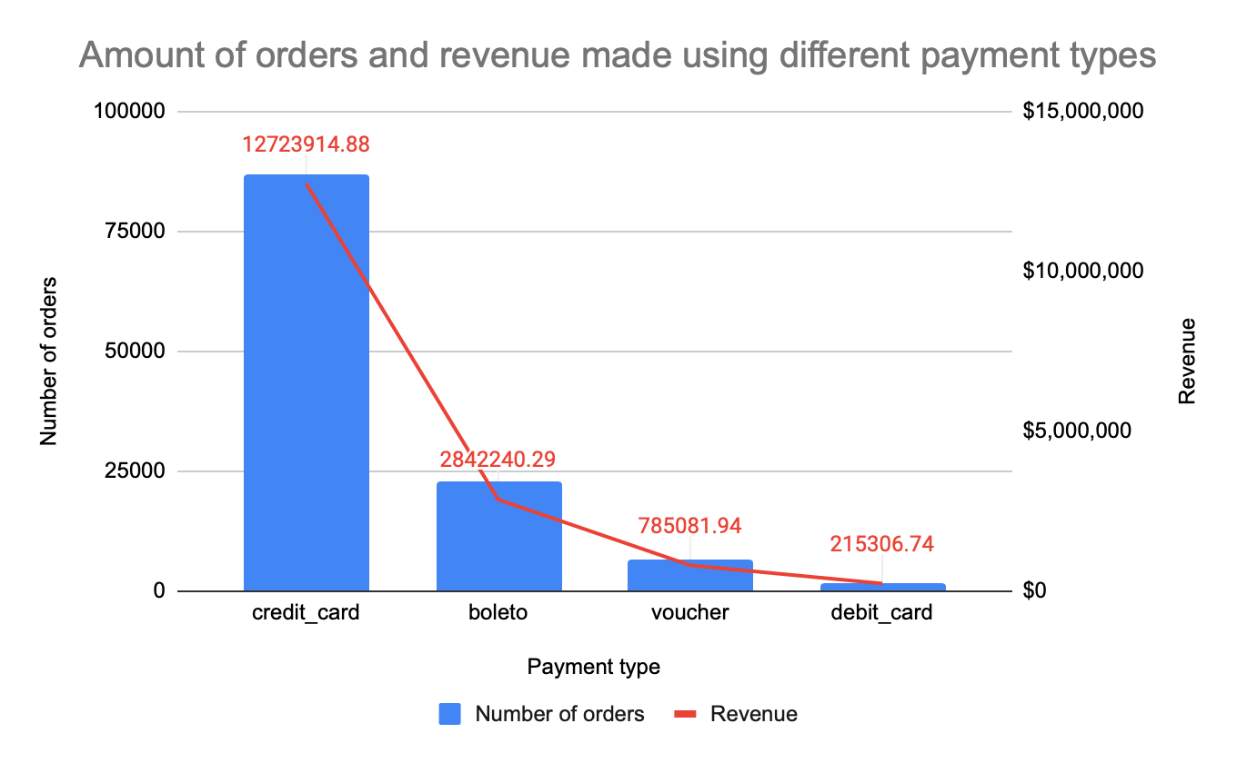
2.Payment methods analysis
Leading category of chosen payment method both in number of orders and revenue made – credit card, debit card is the least used one.

Slide 9
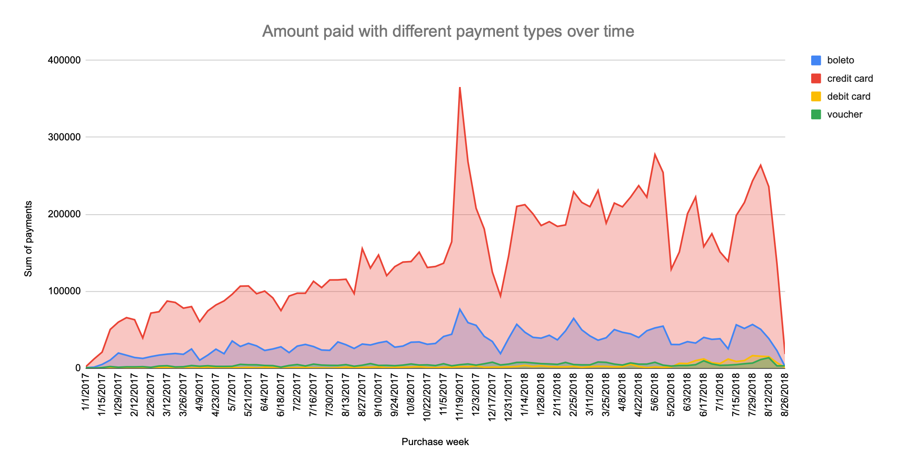
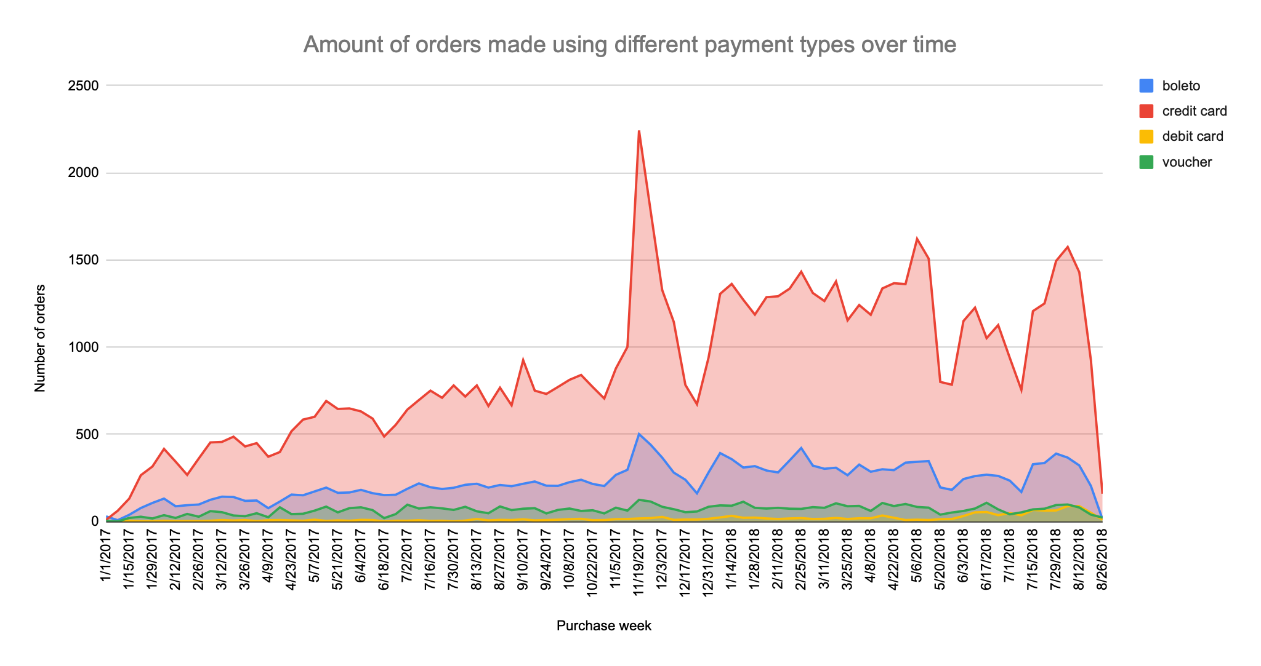
We can see that both the number of orders and amount paid grow over time with a few peaks, like that drastic increase during the week of November 19 2017 (that can be explained by Black Friday event) and the decrease during the weeks of December 2017 (that can be due to Christmas celebrations), etc.
- Evaluation of these peaks and drops in customers over time can be a point for a future analysis.

Slide 10
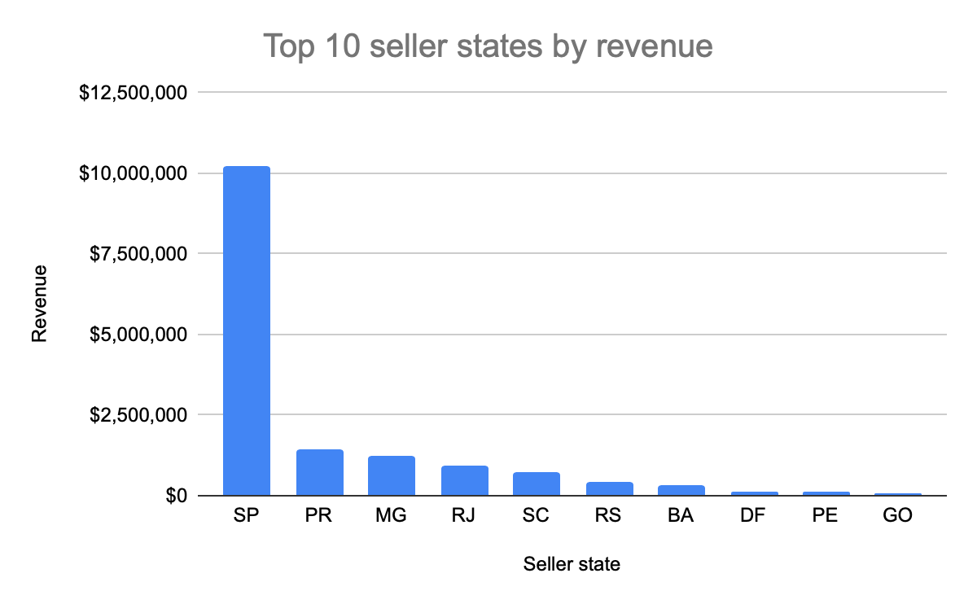
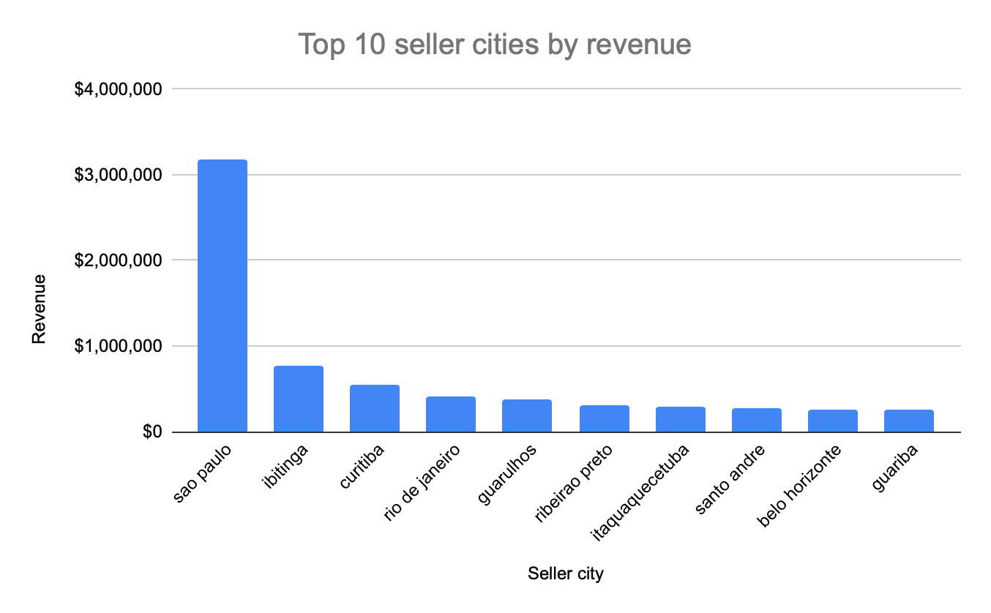
Out of top 10 cities by revenue 7 belong to Sao Paolo state (top 1 state by revenue): Sao Paolo, Ibitinga, Guarulhos, Ribeirao Preto, Itaquaquecetuba, Santo Andre, Guariba. Curitiba belongs to Parana (state N2), Rio De Janeiro to RJ state (N4) and Belo Horizonte is in Minas Gerais(N3 by revenue).

Slide 11
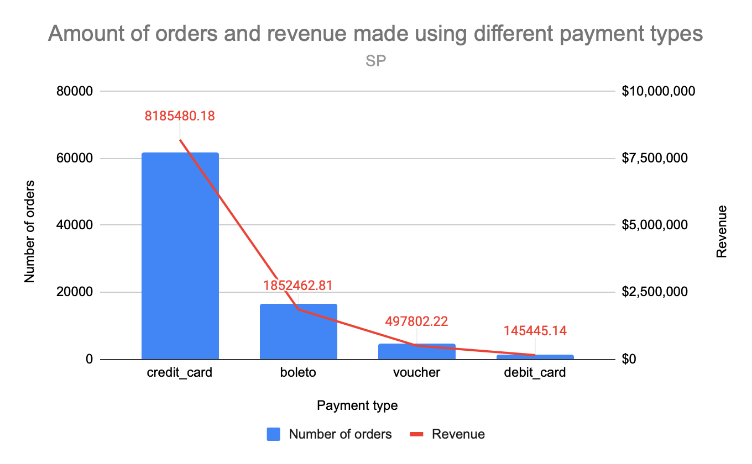
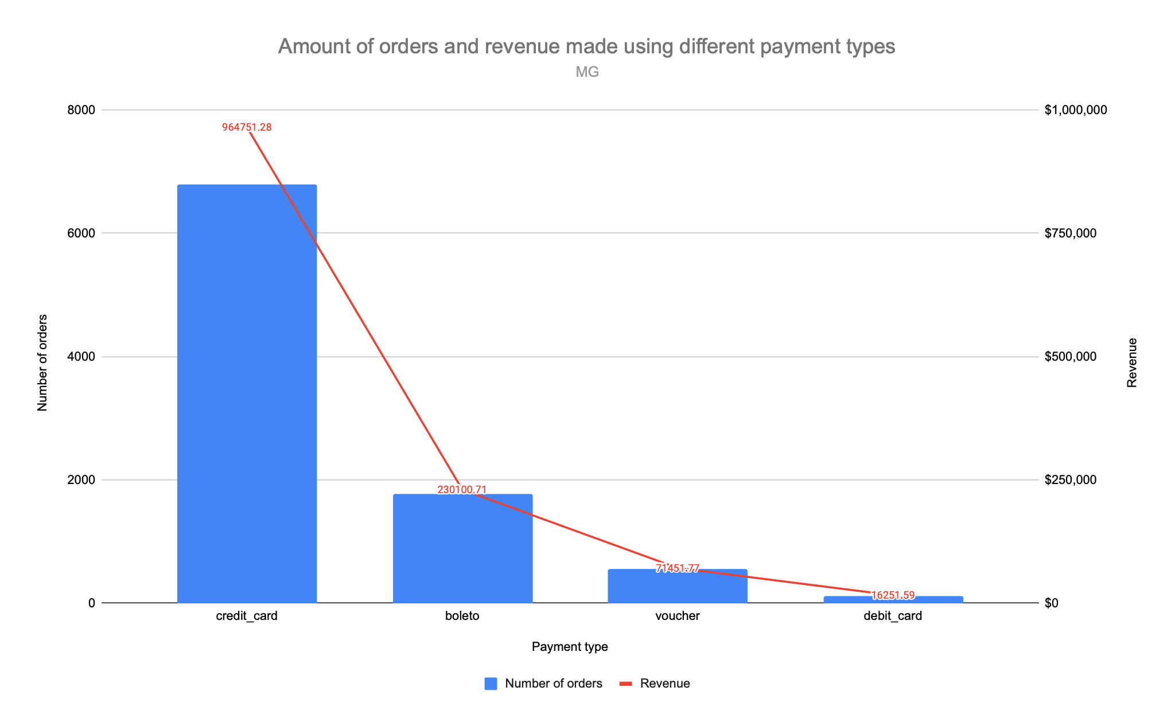

Top 3 seller states by revenue and payment methods their customers chose
Sao Paolo, Minas Gerais and Parana are the top 3 seller states by revenue, and their customers’ chosen payment methods graphs match the original one (with all the data across the states). Leading is credit card, least used is debit card methods.

Slide 12
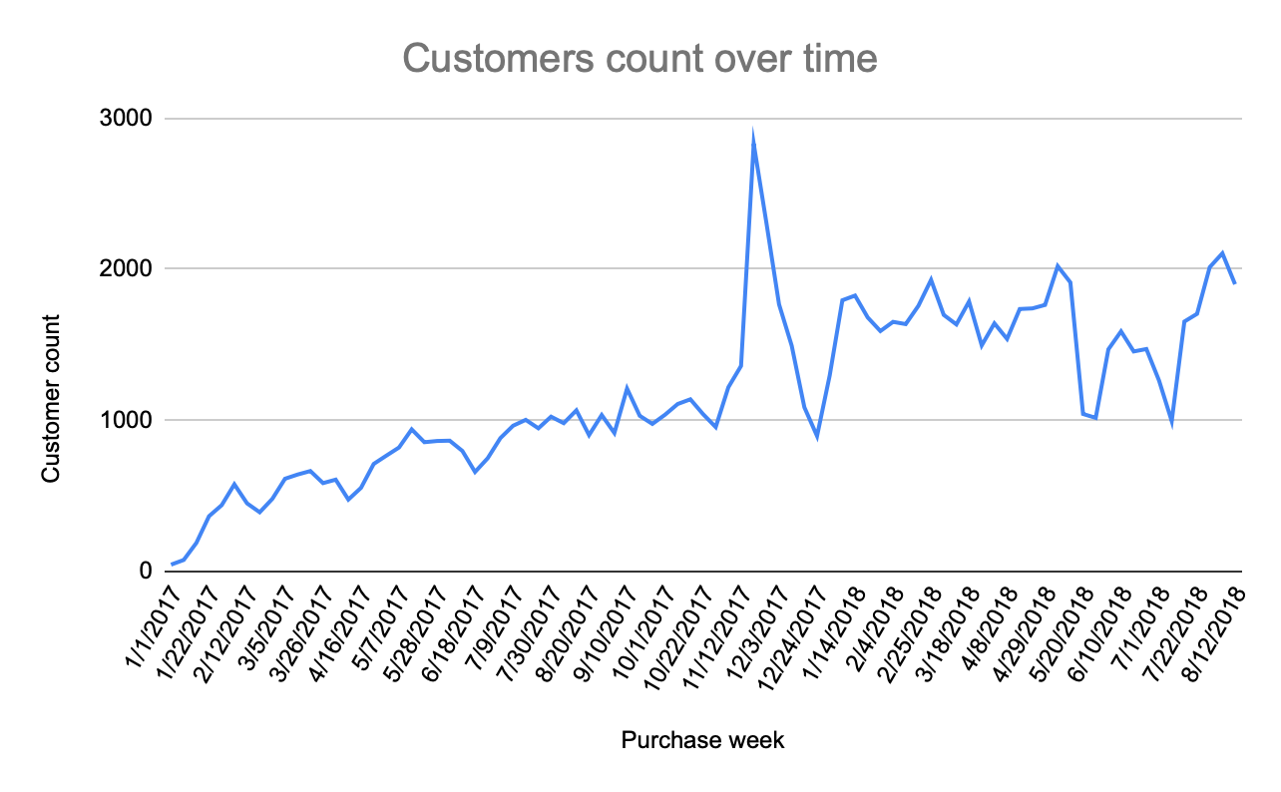
We can see that amount of customers grow with time, meaning our business is attracting more and more clients.
For future analysis – check seller growth over time, and specifically seller and customer growth in different states/cities.

Slide 13
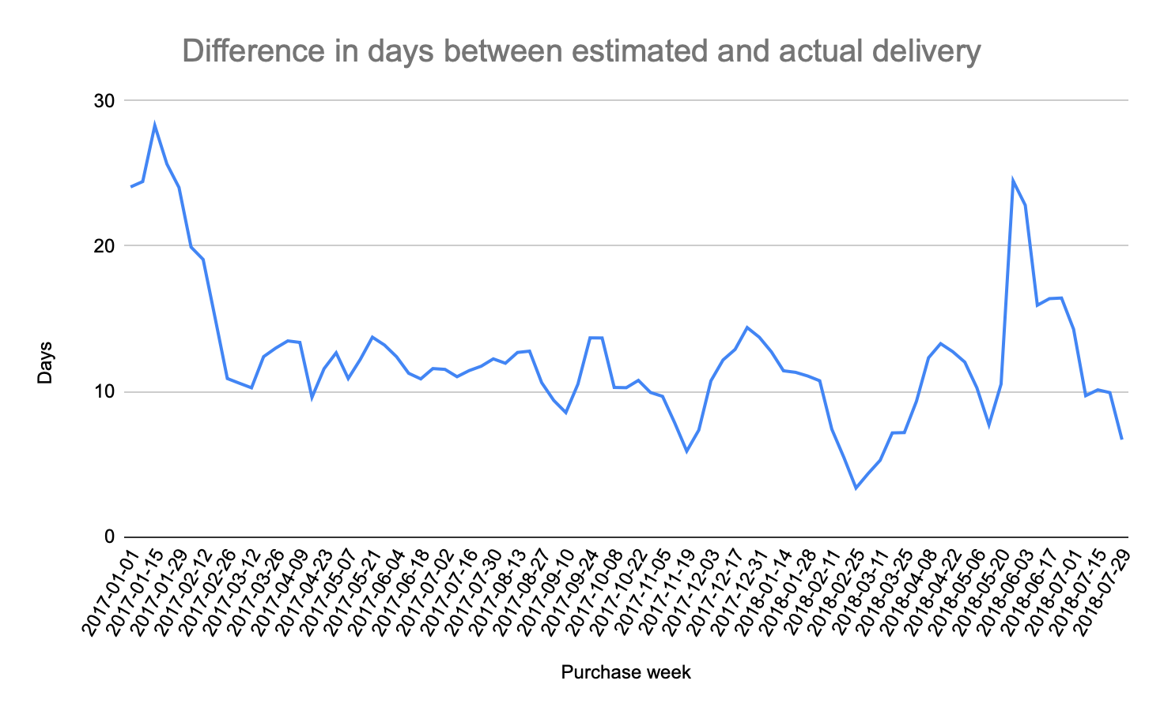
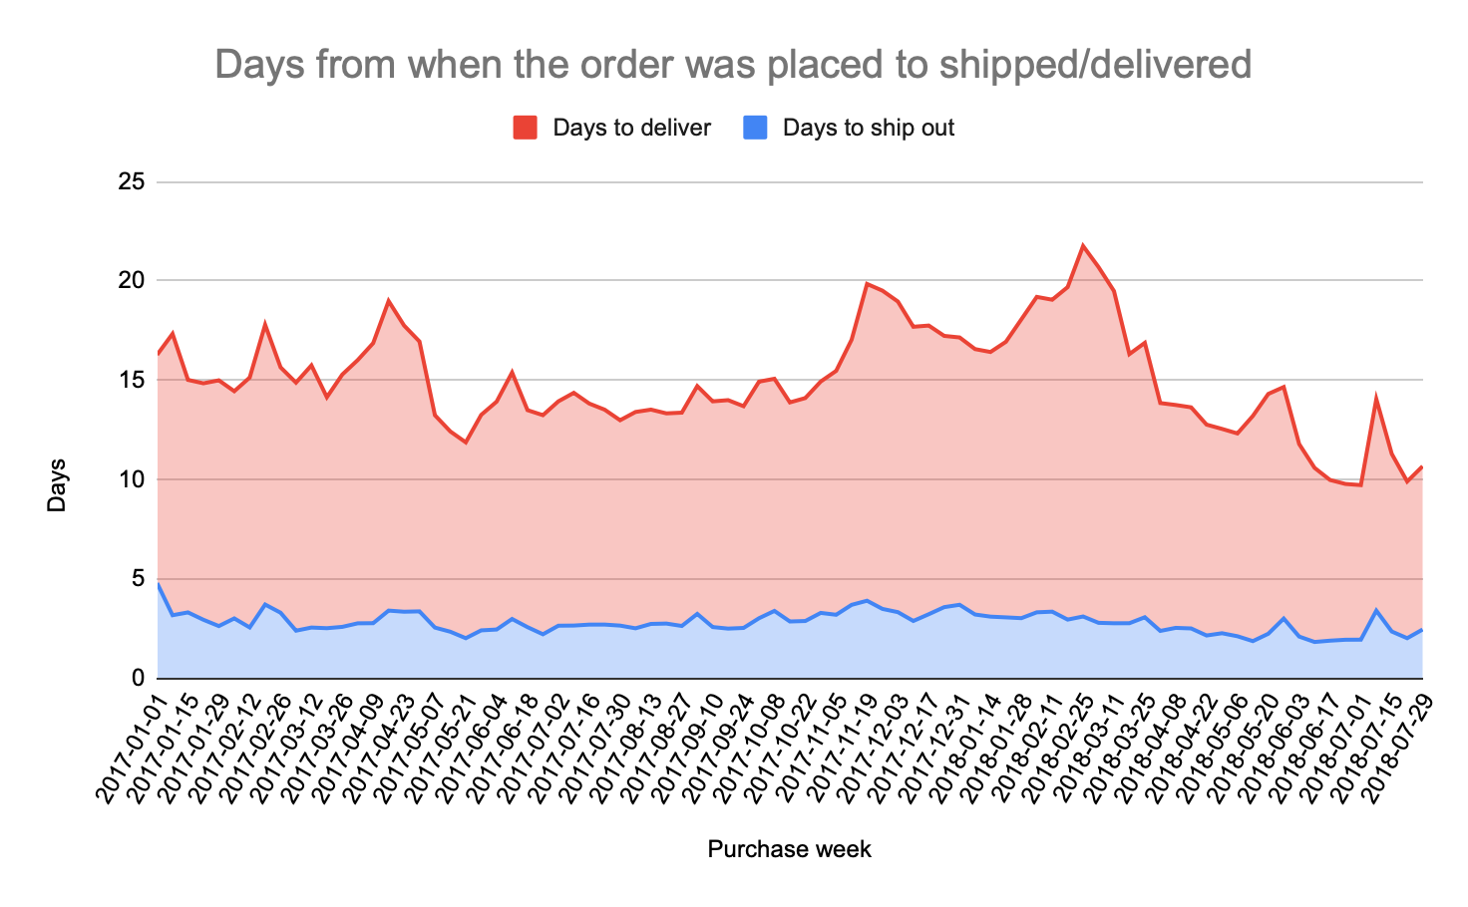
3. Delivery analysis
The estimated delivery dates are usually 10 days more. We should try to predict those delivery dates better, as providing pessimistic predictions for delivery dates may also have a negative impact on conversion rates and other important metrics.
Average time for the order to be approved after it was placed – 9.9 hours. To ship after it was approved – 2.7 days. To deliver after it was shipped – 12.1 days. And this time is decreasing overall in time, with a few peaks in delivery time - that is a point for the future analysis – to find the cause of a possible delay in delivery, to be able to give more accurate prediction.

Slide 14
Recommendations for further analysis
To check what cities/states’ customers chose to pay via installments, what are top categories of goods paid by installment plan in those states, also to check what are the amounts of purchases/number of installments chosen.
To look deeper into peaks and drops of number of orders and revenue in time, to check if there’s any correlation with specific dates (promos, offers, sales, holidays, technical issues, etc).
To analyze reasons for longer delivery time on specific dates, to improve delivery estimation.
To prioritize top selling states like Sao Paolo and Rio de Janeiro by offering sales discounts, free shipping, and returns.

